Slide 1





AUTOMATIC MUSIC GENERATION
Name:Karthickeyan p Guide: P.Raja,Master Trainer
NM-ID: 923821114012
E-Mail ID: karthifire51@gmail.com
Disclaimer: The content is curated for educational purposes only.
Notes:
Slides: Prepare a short slide deck (10-12 slides) summarizing the project objectives, methodology, and key results.

Slide 2
OUTLINE
Abstract of the Project
Problem Statement
Proposed Solution
System Architecture
Live Demo of the Project
Embedded Video of Project
Conclusion
Future Scope

Slide 3
Abstract
The Spotify Music Recommendation System aims to enhance music discovery by using machine learning to analyze and recommend songs based on user preferences. By employing the Spotify songs dataset, available through Kaggle, this system leverages K-Means clustering and cosine similarity to group songs by key audio features such as tempo, danceability, energy, loudness, and other musical characteristics. Once these clusters are created, songs within a cluster are assumed to share similarities in sound and style, making them suitable candidates for recommendations.

Slide 4
Problem Statement
Develop an intelligent system capable of generating original, coherent, and aesthetically pleasing music compositions across different genres, styles, and formats (e.g., melody, harmony, rhythm, and arrangement). The system should be able to create music that is both structurally sound and artistically creative, simulating the compositional process of human musicians.

Slide 5
Proposed Solution
An AI-based automatic music generation solution involves designing a system that can compose music autonomously based on user input, predefined parameters, or complete creative freedom. Here's a proposed solution
Problem Statement
Design an AI model that generates music that is:
Stylistically consistent (e.g., classical, jazz, EDM, etc.)
Adaptable to user preferences (e.g., mood, tempo, or instruments)

Slide 6
System Architecture
Here’s a proposed system architecture for an AI-based automatic music generation solution:
Data Sources
Data Ingestion Layer
Data Storage Layer
Data Processing & Transformation Layer

Slide 7
Live Demo of Project

Slide 8
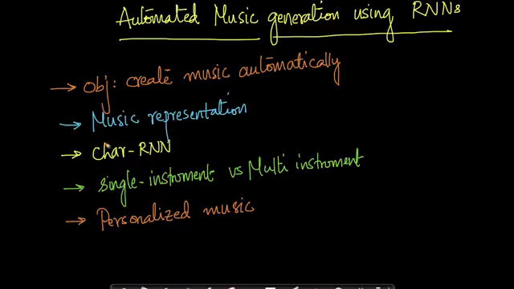
Video of Project Demo

Slide 9
Conclusion
Automatic music generation has made significant strides in recent years, leveraging advanced machine learning models such as RNNs (LSTMs), Transformers, and Variational Autoencoders (VAEs). These models have shown the ability to generate novel and coherent musical compositions in a variety of styles, from classical to jazz, and even experimental genres. However, despite these advancements, several challenges remain in creating systems that consistently generate high-quality, emotionally engaging, and musically complex pieces.

Slide 10
Future Scope
The future scope of AI-based automatic music generation is vast and promising, given the rapid advancements in AI technologies and their integration into creative industries. Here are key areas where this technology is expected to grow:
Integration of Artificial Intelligence (AI) & Machine Learning (ML)
Real-Time Analytics and Decision Making
Voice Search and Conversational Commerce
Blockchain for Transparency and Security
Integration of IoT (Internet of Things)

Slide 11
Thank you!
Notes:
thank you very much for joining this PPT, keep learning.

